Slide 1

Pricing For Your AirBnB Rentals

Slide 2

Target Audience
Problem
REIT Managers
AirBnB Property
Developers
Real Estate Agents
Passive Income Seekers
Determining the fair market value for rental real estate
Pricing your AirBnB properties
Determining the time to enter the market
Providing sound market advice to your clients

Slide 3
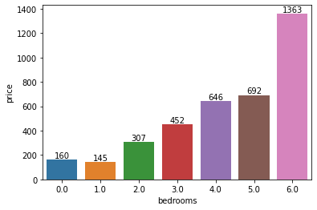
Overview of the Data
Average Price Per Night by Number of Bedrooms
Observations:
Average price per night and number of bedrooms are closely correlated. (i.e. you’re likely to expect to pay or charge more for a property with higher # of bedrooms available).
Studios (0 bedrooms) appears to be priced higher on average.
There is a substantial increase in price per night when bedroom numbers are even. (i.e. 2,4,6)

Slide 4
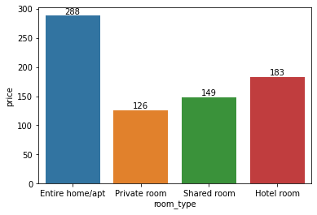
Overview of the Data
Average Price Per Night by Room Type
Observations:
On average, leasing an entire home or apartment is priced at the highest. It is almost 2x the price of Private and Shared room types.
Hotel room type is the second highest priced option as it is expected to offer the most privacy and space for either individual or group.
Private room type is priced lower than shared room type as it is expected to offer privacy with fewer square footage when compared to other room types.

Slide 5
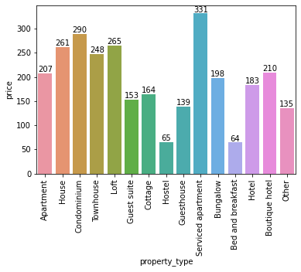
Overview of the Data
Average Price Per Night by Property Type
Observations:
Serviced apartment is the most expensive option. This is most likely driven by additional labor cost.
Hostels/Bed and breakfast types are least expensive. This aligns with the typical real estate/hospitality market.
Property types that similar to private homes which offers the most privacy are priced in the $200 range.
Property types that similar to hotels/motels where there are more shared spaces are priced in the mid $100 and up to $200.

Slide 6

Machine Learning Model
Prediction of Price: Regression
Tested Models: KNeighbors, Random Tree, Linear
Chosen Model: KNeighbors
Lowest MAE & RMSE score.
Measures the difference between prediction and the actual target price.
Strengths:
Simple
Adaptable to change
KNN works well with small number of input variables
Weakness:
It’s strength is also its weakness. As the numbers of variables grow, algorithm struggles to predict the output of new data point.
Sensitive to outliers - prone to Skewed datasets
Metrics | KNeighbors | Random Tree | Linear
MAE | 88 | 114 | 117
MSE | 63,338 | 194,022 | 78,461
RMSE | 251 | 440 | 280
R2 | .242 | -1.321 | .061

